Slide 1
Data Link Layer Functions
1. Providing a well-defined service interface to the network layer.
2. Dealing with transmission errors.
3. Regulating the flow of data so that slow receivers are not swamped by fast senders.

Slide 2
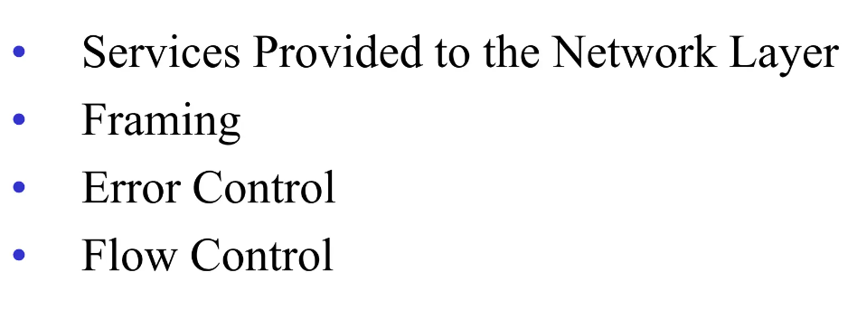
DataLink Layer Design Issues

Slide 3
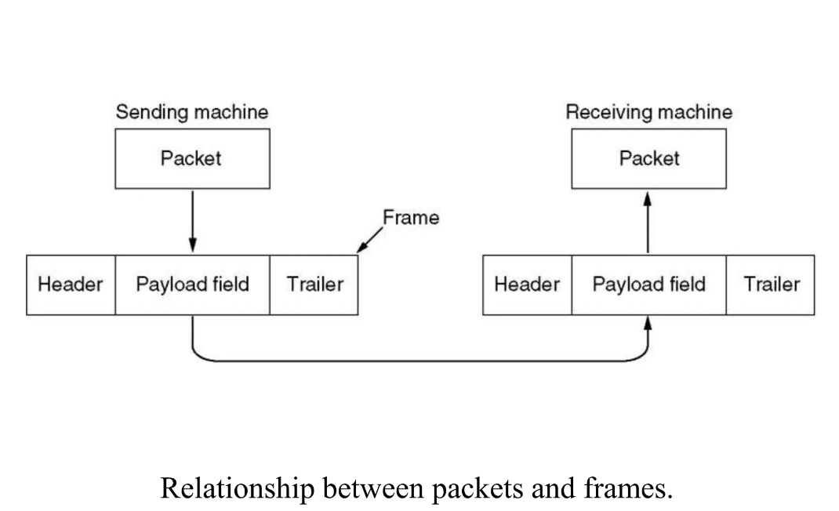
Functions of Data link layer

Slide 4
Cont,
To accomplish these goals, the data link layer takes the packets it gets from the network layer and encapsulates them into frames for transmission.
Each frame contains a frame header, a payload field for holding the packet, and a frame trailer, as illustrated in Fig.

Slide 5
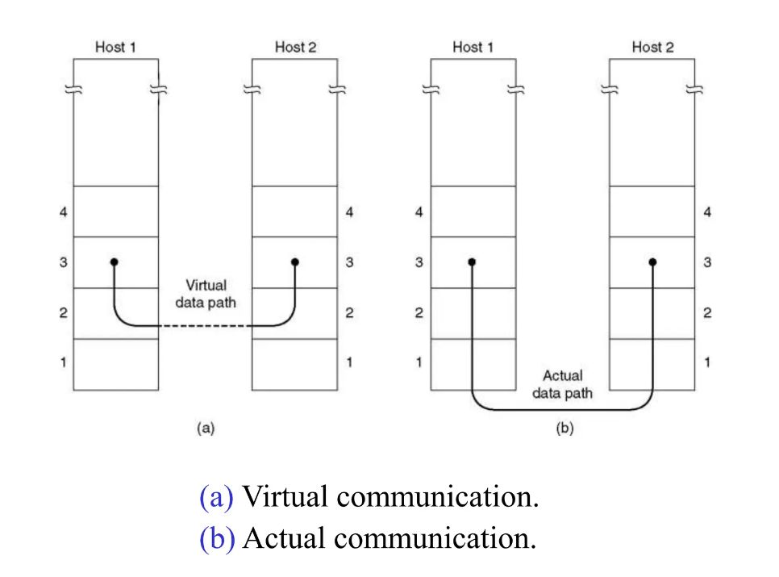
Services provided to Network Layer

Slide 6
The function of the data link layer is to provide services to the network layer.
The principal service is transferring data from the network layer on the source machine to the network layer on the destination machine.
On the source machine isan entity, call it a process, in the network layer that hands some bits to the data link layer for transmission to the destination.
The job of the data link layer is to transmit the bits to the destination machine so they can be handed over to the network layer there fig a.
The actual transmission follows the path of Fig b, but it is easier to think in terms of two data link layer processes communicating using a data link protocol.

Slide 7
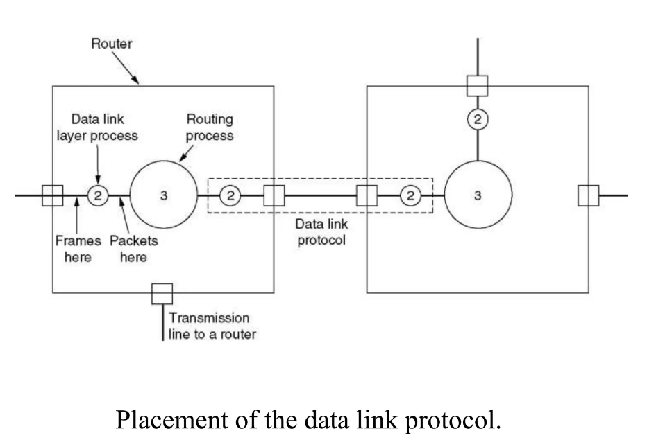
Service provided to Network Layer(2)

Slide 8
Framing
The usual approach is for the data link layer to break up the bit stream into discrete frames, compute a short token called a checksum for each frame, and include the checksum in the frame when it is transmitted. (Checksum algorithms will be discussed later in this chapter.)
When a frame arrives at the destination, the checksum is recomputed.
If the newly computed checksum is different from the one contained in the frame, the data link layer knows that an error has occurred and takes steps to deal with it (e.g., discarding the bad frame and possibly also sending back an error report).
Breaking up the bit stream into frames is more difficult than it at first appears.

Slide 9
four methods:
1. Byte count.
2. Flag bytes with byte stuffing.
3. Flag bits with bit stuffing.
4. Physical layer coding violations.

Slide 10
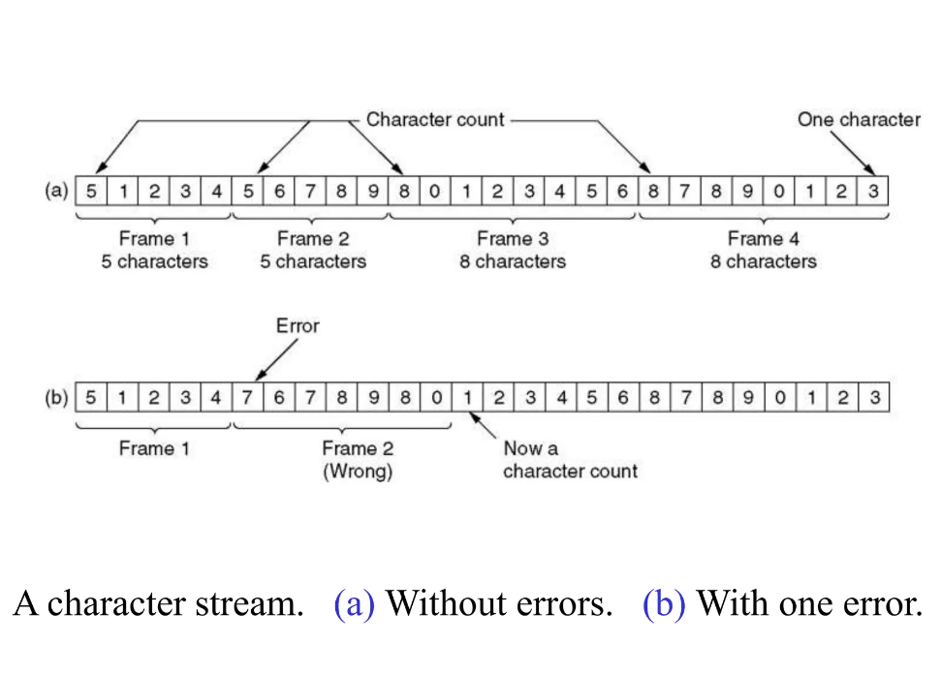
Framing

Slide 11
The first framing method uses a field in the header to specify the number of bytes in the frame.
When the data link layer at the destination sees the byte count, it knows how many bytes follow and hence where the end of the frame is.

Slide 12
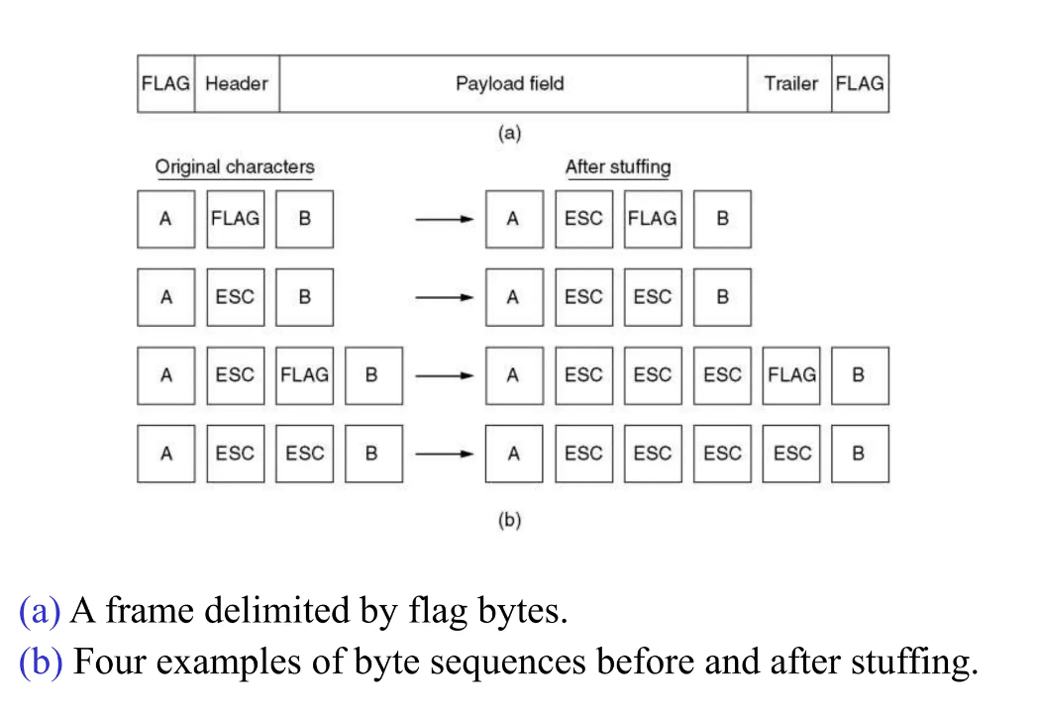
Framing(2)

Slide 13
Cntn,
The second framing method gets around the problem of resynchronization after an error by having each frame start and end with special bytes.
Often the same byte, called a flag byte, is used as both the starting and ending delimiter.
This byte is shown in Fig. 3-4(a) as FLAG. Two consecutive flag bytes indicate the end of one frame and the start of the next.
Thus, if the receiver ever loses synchronization it can just search for two flag bytes to find the end of the current frame and the start of the next frame.

Slide 14
Cont,
It may happen that the flag byte occurs in the data, especially when binary data such as photographs or songs are being transmitted.
This situation would interfere with the framing.
One way to solve this problem is to have the sender’s data link layer insert a special escape byte (ESC) just before each ‘‘accidental’’ flag byte in the data.
Thus, a framing flag byte can be distinguished from one in the data by the absence or presence of an escape byte before it.
The data link layer on the receiving end removes the escape bytes before giving the data to the network layer. This technique is called byte stuffing.

Slide 15
Cont,
The byte-stuffing scheme depicted in Fig. 3-4 is a slight simplification of the one used in PPP (Point-to-Point Protocol), which is used to carry packets over communications links

Slide 16
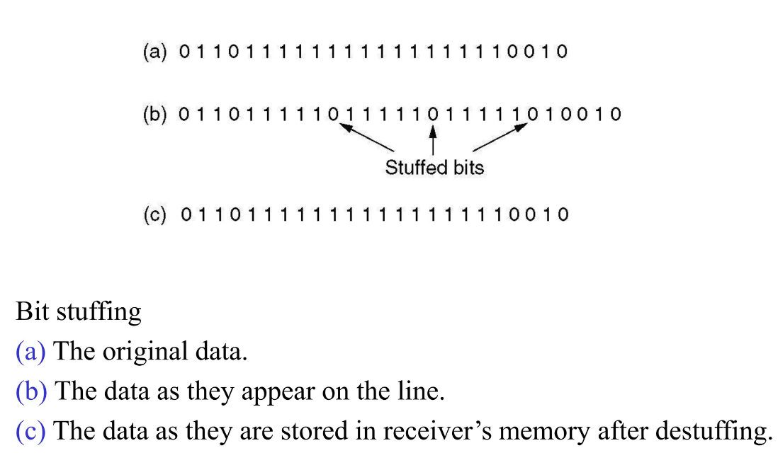
Framing(3)

Slide 17
The third method of delimiting the bit stream gets around a disadvantage of byte stuffing, which is that it is tied to the use of 8-bit bytes.
Framing can be also be done at the bit level, so frames can contain an arbitrary number of bits made up of units of any size. It was developed for the once very popular HDLC (Highlevel Data Link Control) protocol.
Each frame begins and ends with a special bit pattern, 01111110 or 0x7E in hexadecimal. This pattern is a flag byte.
Whenever the sender’s data link layer encounters five consecutive 1s in the data, it
automatically stuffs a 0 bit into the outgoing bit stream.
This bit stuffing is analogous to byte stuffing, in which an escape byte is stuffed into the outgoing character stream before a flag byte in the data. It also ensures a minimum density of transitions that help the physical layer maintain synchronization. USB (Universal Serial Bus) uses bit stuffing for this reason.

Slide 18
Error Detection and Correction
One strategy is to include enough redundant information to enable the receiver to deduce what the transmitted data must have been.
The other is to include only enough redundancy to allow the receiver to deduce that an error has occurred (but not which error)
The former strategy uses error-correctingcodes and the latter uses error-detecting codes.
The use of error-correcting codes is often referred to as FEC (Forward Error Correction).

Slide 19
Error-correcting codes:
1. Hamming codes.
2. Binary convolutional codes.
3. Reed-Solomon codes.
4. Low-Density Parity Check codes.
All of these codes add redundancy to the information that is sent
A frame consists of m data (i.e., message) bits and r redundant (i.e. check) bits.

Slide 20
Cntn,
In a block code, the r check bits are computed solely as a function of the m data bits with which they are associated, as though the m bits were looked up in a large table to find their corresponding r check bits.
In a systematic code, the m data bits are sent directly, along with the check bits, rather than being encoded themselves before they are sent.
In a linear code, the r check bits are computed as a linear
function of the m data bits.
Exclusive OR (XOR) or modulo 2 addition is a popular choice.
This means that encoding can be done with operations such as matrix multiplications or simple logic circuits.

Slide 21
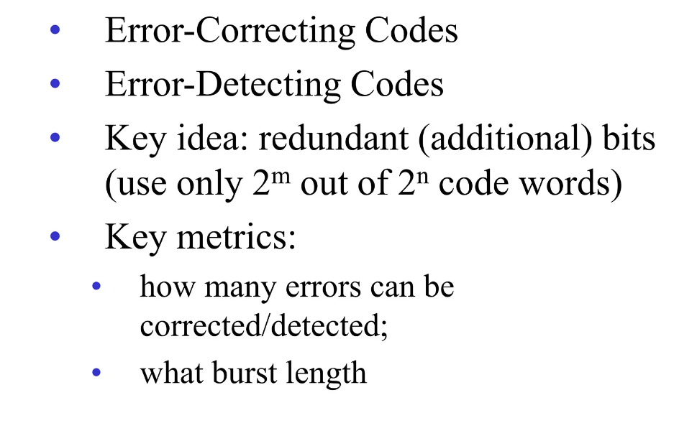
Error Detection and Correction

Slide 22
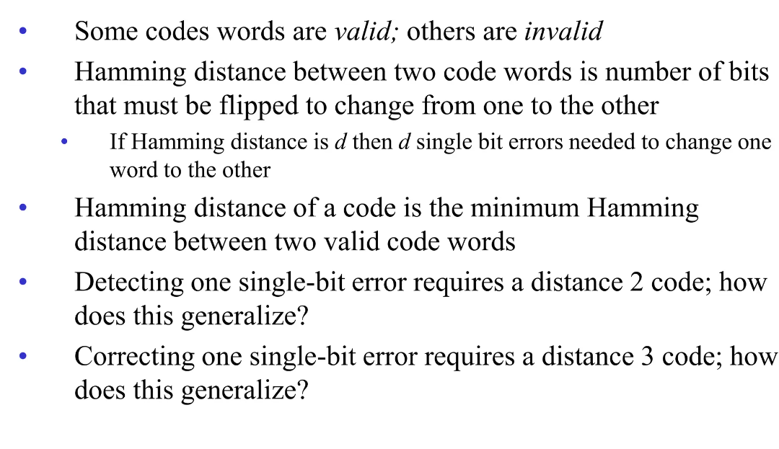
Hamming Distance

Slide 23
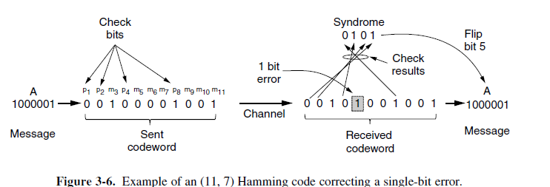

Slide 24
Convolutional code
In a convolutional code, an encoder processes a sequence of input bits and generates a sequence of output bits.
There is no natural message size or encoding boundary as in a block code.
The output depends on the current and previous input bits.
That is, the encoder has memory. The number of previous bits on which the output depends is called the constraint length of the code.
Convolutional codes are specified in terms of their rate and constraint length.
Convolutional codes are widely used in deployed networks, for example, as
part of the GSM mobile phone system, in satellite communications, and in 802.11.
As an example, a popular convolutional code is shown in Fig. 3-7. This code is known as the NASA convolutional code of r = 1/2 and k = 7, since it was first
used for the Voyager space missions starting in 1977.
Since then it has been liberally reused, for example, as part of 802.11.

Slide 25
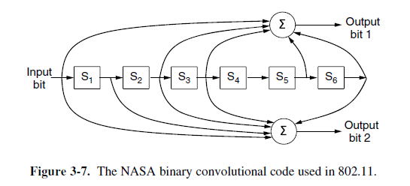

Slide 26
In Fig. 3-7, each input bit on the left-hand side produces two output bits on the right-hand side that are XOR sums of the input and internal state.
Since it deals with bits and performs linear operations, this is a binary, linear convolutional code.
Since 1 input bit produces 2 output bits, the code rate is 1/2.
It is not systematic since none of the output bits is simply the input bit.

Slide 27
Reed-Solomon code
Like Hamming codes, Reed-Solomon codes are linear block codes, and they are often systematic too.
Unlike Hamming codes, which operate on individual bits, Reed-Solomon codes operate on m bit symbols.
Naturally, the mathematics are more involved,

Slide 28
Reed-Solomon codes are actually defined as polynomials that operate over finite fields, but they work in a similar manner.
For m bit symbols, the codewords are 2m−1 symbols long.
A popular choice is to make m = 8 so that symbols are bytes.
A codeword is then 255 bytes long. The (255, 233) code is widely used;
It adds 32 redundant symbols to 233 data symbols.

Slide 29
LDPC (Low-Density Parity Check) code
LDPC codes are linear block codes that were invented by Robert Gallagher in his doctoral thesis (Gallagher, 1962).
In an LDPC code, each output bit is formed from only a fraction of the input
bits.
This leads to a matrix representation of the code that has a low density of 1s,
hence the name for the code.
The received codewords are decoded with an approximation algorithm that iteratively improves on a best fit of the received data to a legal codeword.
This corrects errors.
LDPC codes are practical for large block sizes and have excellent error-correction
abilities that outperform many other codes (including the ones we have
looked at) in practice.
For this reason they are rapidly being included in new protocols.
They are part of the standard for digital video broadcasting, 10 Gbps Ethernet, power-line networks, and the latest version of 802.11.

Slide 30
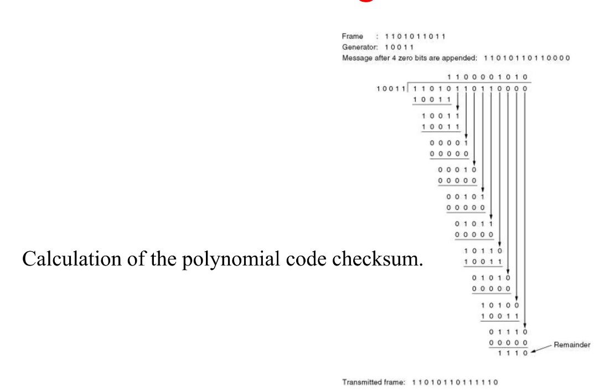
Error Detecting Code

Slide 31
Error-detecting codes
They are all linear, systematic block codes:
1. Parity.
2. Checksums.
3. Cyclic Redundancy Checks (CRCs).

Slide 32
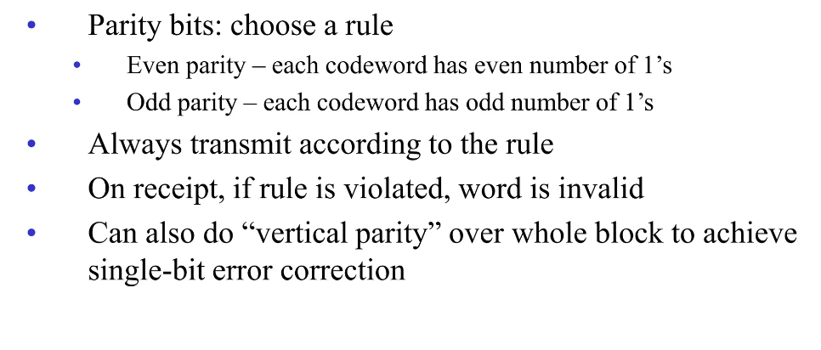
Parity

Slide 33
Checksum
‘‘checksum’’ is often used to mean a group of check bits associated with a message, regardless of how are calculated.
A group of parity bits is one example of a checksum.
However, there are other, stronger checksums based on a running sum of the data bits of the message.
The checksum is usually placed at the end of the message, as the complement of the sum function.
This way, errors may be detected by summing the entire received codeword, both data bits and checksum. If the result comes out to be zero, no error has been detected.
One example of a checksum is the 16-bit Internet checksum used on all Internet packets as part of the IP protocol (Braden et al., 1988).
This checksum is a sum of the message bits divided into 16-bit words. Because this method operates on words rather than on bits, as in parity, errors that leave the parity unchanged
can still alter the sum and be detected.
For example, if the lowest order bit in two different words is flipped from a 0 to a 1, a parity check across these bits would fail to detect an error.
However, two 1s will be added to the 16-bit checksum to produce a different result. The error can then be detected.

Slide 34
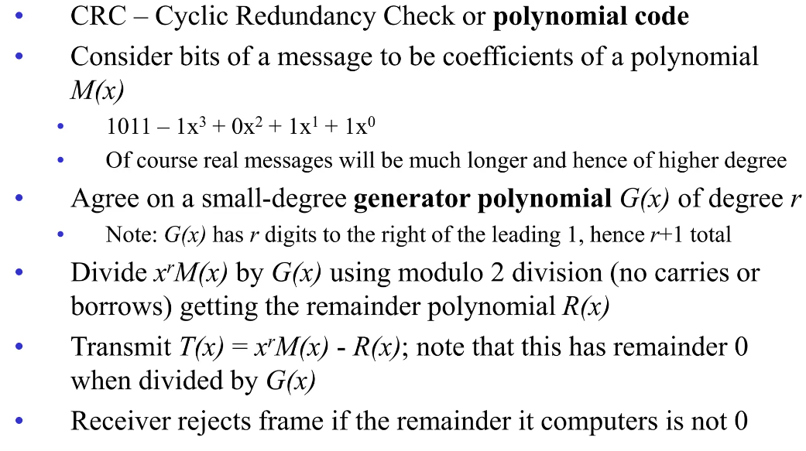
CRC schemes

